Slide 1
Data Modernization Framework
Hitachi Vantara
Wednesday, 07 September 2022

Slide 2

Our Data Modernization Services
Business Case Analysis
Maturity Curve Analysis
Data Discovery
Analytics Outcomes
Organizational Impacts
Data Lake, EDW Re-architecture
Data Engineering
Cloud Transformation
DataOps Automation
Data Reliability
Data Governance
Data Quality
Metadata/Catalogue
Master Data
Data Security
Data Operations automation
Continuous Delivery
Data-Driven Culture
Data Strategy & Roadmap
Modernize Data Fabric
Govern Enterprise Data
Operationalize DataOps
Data Driven Enterprise
© Hitachi Vantara LLC 2020. All Rights Reserved.
Notes:
Rehost - “Lift and shift / re-fit” migration of existing systems with minimal changes to meet your regulatory or business needs
Refactor - Migrate, Upgrade and reconfigure existing systems to take advantage of emerging technologies and establish your foundations in a multi-cloud future
Reengineer - Design & build new “digital-native-like” systems to replace existing ones enabling you to accelerate your innovation potential

Slide 3

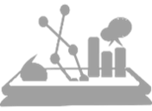


Data Modernization Approach
Business Drivers
Envision – Data Strategy & Roadmap
Evaluate
Execute at Scale
Business Excellence
Paths
Agile Insights driven enterprise
Rapid & Exponential Enterprise Data Growth
Faster access to Curated , Scalable & Trusted Data
Data Lakes / EDW Re-architecture
Data Fabric Modernization
AI-ready Architecture
Blueprint for a modern data ecosystem
Re-platform
Operational Excellence
Enterprise Data Governance
Cost Optimization
Capex to OpEx
Automation
Scarcity of Talent
Migrate
Retain
Business Agility
Data Operations (DataOps)
Faster Time to Market
Continuous Innovation
Integrated delivery processes
Organizational Adaptability and change
Maturity Model
multi-level maturity model
Guiding Principles
Modern Design Patterns & strategies
Retire & Decommission
Enabled by Hitachi Platforms, Accelerators & Tools

Slide 4
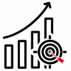





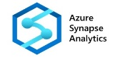
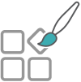
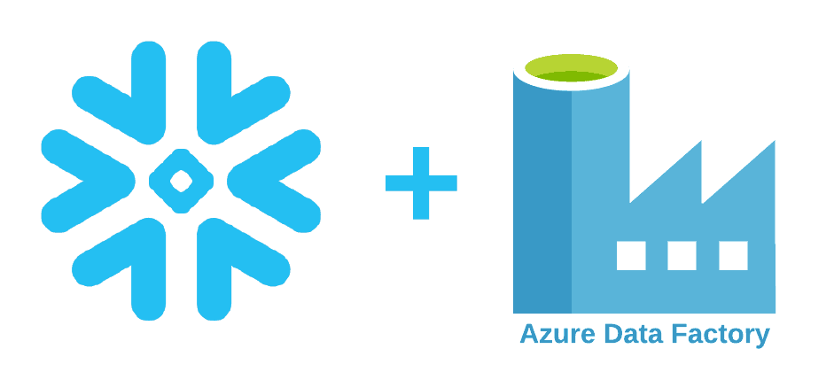
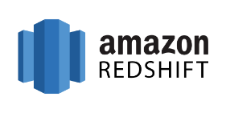

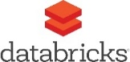

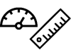
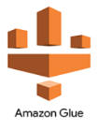

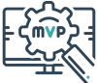




Hitachi Intelligent Data Modernization Offering
Process driven
Automation Enabled
modernization portfolio
Sources
Targets
Business Goals and Objectives
Discovery Sessions
Teradata
Netezza
Oracle
Greenplum
Hive
SQL Server
DB2
Oracle
Redshift/ Postgres
Data & Analytics
Strategy
Data Modernization Blueprint
Measure Success - Matrices & KPIs
Data modernization candidates
DataStage
Informatica
SSIS
SAP BODI
Ab Initio
MVP Assessment
Data Modernization Backlogs and Roadmap
Partner
Accelerated, Process Driven, Automation Enabled Modernization Assessment & Implementation Roadmap

Slide 5

Get To Consumption Faster
WAVE & TEST PLAN
Automatically determine the order to migrate and what to test
TRANSLATE
Test Automation Accelerators
100% QA-ready SQL and ETL for any cloud target
QA
Automatically generate test case scripts to accelerate QA timelines
Competitive Advantage: Automation at Every Step

Slide 6
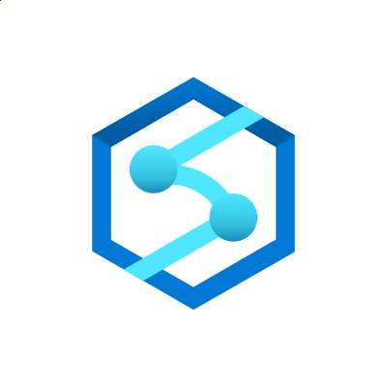






SHIFTTM Translator Database Code Conversion
Syntax-based Translation
(e.g. data type conversion, expression conversion)
DDL/DML
Views and
Materialized Views
Stored Procedures
X-Factor Cases
(e.g. Dynamic SQL, Scripting Frameworks, Proprietary Functions)
Semantic-based Translation
(e.g. PL/SQL, code optimization)

Slide 7







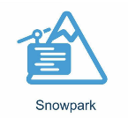
SHIFTTM Translator ETL Modernization
Ingest / Egress
Metadata for Data Load tools
SHIFT Intermediary Language
Control Flows
…
Transform Flows
SQL

